Slide 1
Employee Data Analysis using Excel
STUDENT NAME:
REGISTER NO:
DEPARTMENT:
COLLEGE

Slide 2
PROJECT TITLE
Employee Performance Analysis using Excel

Slide 3


AGENDA
Problem Statement
Project Overview
End Users
Our Solution and Proposition
Dataset Description
Modelling Approach
Results and Discussion
Conclusion
3/21/2024 Annual Review

Slide 4

PROBLEM STATEMENT
As a human resources manager, I need to better understand our company's employee data to identify trends, optimize talent management, and improve overall business performance. However, our current employee data is scattered across various sources, and we lack a comprehensive analysis framework to extract actionable insights.

Slide 5

PROJECT OVERVIEW
.
Develop a comprehensive employee analysis framework to integrate and analyze data from various sources, providing actionable insights for data-driven decision-making in talent management.

Slide 6

WHO ARE THE END USERS?
1. HR Business Partners
2. HR Generalists
3. Talent Management Teams
4. Recruiters
5. Line Managers
6. Business Leaders
7. Compensation and Benefits Analysts
8. Diversity, Equity, and Inclusion (DEI) Specialists
9. Organizational Development Specialists
10. Data Analysts and Scientists

Slide 7

OUR SOLUTION AND ITS VALUE PROPOSITION
Solution:
Develop a comprehensive employee data analytics platform that integrates data from various sources (HR systems, performance management tools, surveys, etc.)
Value proportion:
Data-Driven Decision Making: Enable HR and business leaders to make informed decisions about talent management, backed by data and analytics

Slide 8
Dataset Description
DATASET NAME
DESCRIPTION
DATASOURCE
DATA FIELD
DATA FORMAT
DATA VOLUME
DATA QUALITY

Slide 9

THE "WOW" IN OUR SOLUTION
Predictive Insights for Personalized Employee Journeys.
Using advanced machine learning algorithms and natural language processing, the employee analysis data solution provides predictive insights that enable personalized employee journeys.
3/21/2024 Annual Review
‹#›

Slide 10
MODELLING
Data Modeling:
1. Entity-Relationship Model (ERM): Define entities (e.g., Employee, Department, Job Title) and relationships (e.g., Employee works in Department) to structure the data.
2. Star Schema: Organize data into fact tables (e.g., Employee Performance, Employee Engagement) surrounded by dimension tables (e.g., Date, Department) for efficient querying.
‹#›

Slide 11
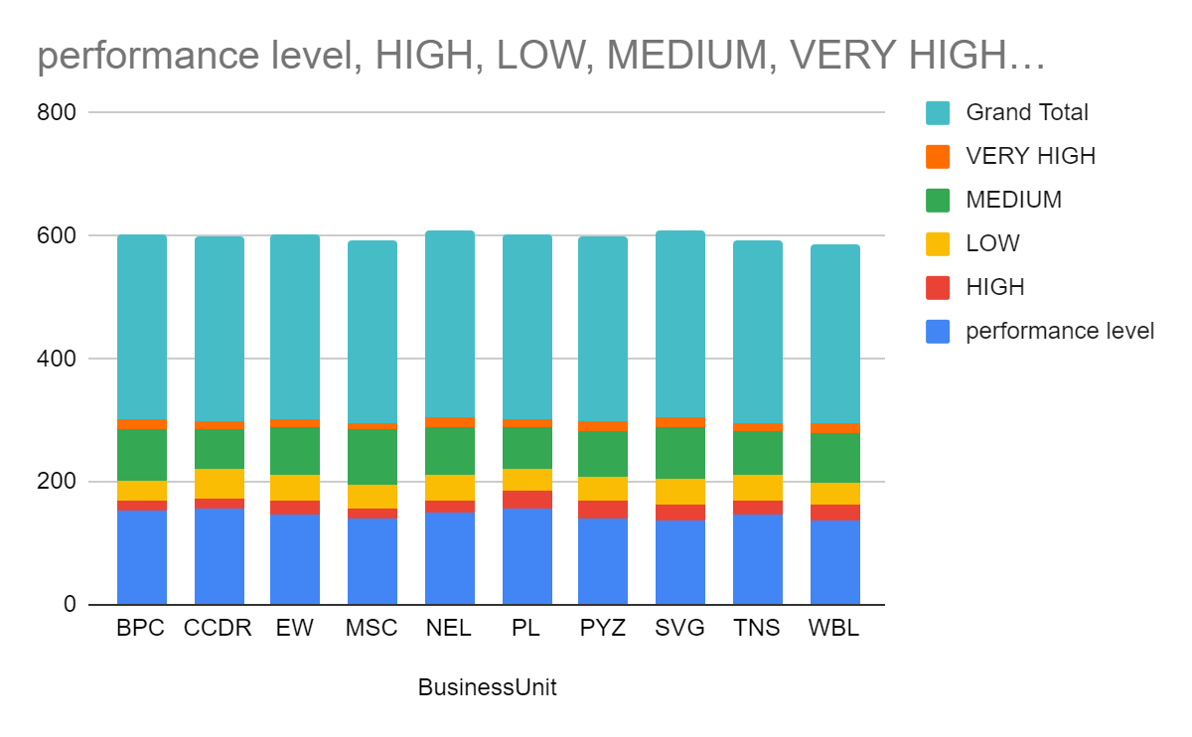
RESULTS
‹#›

Slide 12
conclusion
The employee analysis data project provides insights into our organization's talent landscape, enabling data-driven decisions. Key findings include:
- Predictive models identify high-risk turnover employees
- Employee engagement is linked to career development and manager quality
- Diversity initiatives have improved representation and retention
Recommendations include personalized career plans, enhanced manager training, and expanded diversity initiatives. By leveraging this data, we can improve employee retention, career growth, and drive business outcomes.

